Slide 1
UNIT SIX
EXCHANGE RATE

Slide 2
EXCHANGE RATE
Amount of domestic currency requires to purchase $1.00 of foreign currency.
Eg. If the current exchange rate between US & JA in 2010 was 87:1, this means it requires 87 Jamaican Dollar to buy one US Dollar.
In January & February 2015, the average rates for the months were 115.32 & 115.7 respectively.

Slide 3
MAJOR TYPES OF CURRENCIES
UNITED STATES {$US}
POUND STERLING {£}
EURO DOLLAR {€}
CANADIAN DOLLAR {$}

Slide 4
TYPES OF EXCHANGE RATE SYSTEM
FLOATING SYSTEM or fluctuating exchange rate ----- One that is dominated by the market {demand & supply of the currency}
MANAGED EXCHANGE RATE SYSTEM Also known as "dirty" float in which a government intervenes at some frequency to change the direction of the float by buying or selling currencies---

Slide 5
FIXED EXCHANGE RATE SYSTEM -----
A fixed exchange-rate system is a currency system in which governments try to maintain their currency value constant against one another. ...
An early form of fixed exchange rates was to specify the value of a nation's currency in terms of gold (the "gold standard").

Slide 6
NOMINAL EXCHANGE RATE
The official quote of an exchange rate. For example, when one changes dollars for pounds, the bank lists an exchange rate of, say, two dollars for one pound. This is the nominal exchange rate. While this indicates the number of pounds one receives for a dollar (or vice versa), it does not show the purchasing power of the pound versus that of the dollar

Slide 7
REAL EXCHANGE RATE
The most common definition of the real rate is the nominal exchange rate adjusted by price levels.
where is the log exchange rate defined in units of home currency per unit of foreign, and p and p* are log price levels.
If purchasing power parity (PPP) holds, then q is always unity (or a constant, if price indices are used). One should expect PPP to hold in a world where
transportation and transactions costs were negligible, consumption baskets were identical, and no
arbitrage profits existed. Absent these conditions, the real exchange rate will vary.

Slide 8
TRADE-WEIGHTED EXCHANGE RATE
A way of evaluating the strength of a country's currency by weighting its value according to the relative amount of trade carried out with each of its trading partners. If the majority of a country's trade is with Japan, for instance, then the movement of its currency against the yen will be given greater importance in the overall measurement of the exchange rate's value. This overall value is normally expressed as an index level that changes on a daily basis.

Slide 9
FOREIGN EXCHANGE FLUCTUATION {1990 – 2010}
Year | Average annual $J/US$ exchange rate | Year | Average annual $J/US$ exchange rate
1990 | 7.18 | 2000 | 43.32
1991 | 12.85 | 2001 | 46.08
1992 | 23.01 | 2002 | 48.54
1993 | 25.68 | 2003 | 57.93
1994 | 33.35 | 2004 | 61.34
1995 | 35.56 | 2005 | 62.50
1996 | 37.02 | 2006 | 65.88
1997 | 35.58 | 2007 | 69.06
1998 | 36.68 | 2008 | 72.92
1999 | 39.33 | 2009 | 88.49
2000 | 43.32 | 2010 | 87.38

Slide 10
TYPES OF CURRENCY MARKET
1. Spot Market:
- immediate transaction
- recorded by 2nd business day

Slide 11
Forward Market:
- transactions take place at a specified future date

Slide 12
PARTICIPANTS IN THE EXCHANGE MARKET
Spot Market:
a. commercial banks
b. brokers
c. customers of commercial and central banks

Slide 13
Forward Market
a. arbitrageurs
b. traders
c. hedgers
d. speculators

Slide 14
The Market for Foreign Exchange
In a world where there are only two countries, the United States and Jamaica, the demand for US Dollars is comprised of holders of Jamaica Dollars wishing to acquire US Dollars. The supply of US Dollars is comprised of holders of US Dollars seeking to exchange them for Jamaican dollars.
Notes:
If you think the U.S. dollar is going to decline in value relative to the pound, you may want to hold some of your wealth in the form of pounds.

Slide 15
The Market for Foreign Exchange
Some Private Buyers and Sellers in International Exchange Markets: United States and Great Britain
THE DEMAND FOR POUNDS (SUPPLY OF DOLLARS)
Firms, households, or governments that import British goods into the United States or wish to buy British-made goods and services U.S. citizens traveling in Great Britain Holders of dollars who want to buy British stocks, bonds, or other financial instruments U.S. companies that want to invest in Great Britain Speculators who anticipate a decline in the value of the dollar relative to the pound
Notes:
If you think the U.S. dollar is going to decline in value relative to the pound, you may want to hold some of your wealth in the form of pounds.

Slide 16
The Market for Foreign Exchange
Some Private Buyers and Sellers in International Exchange Markets: United States and Great Britain
THE SUPPLY OF POUNDS (DEMAND FOR DOLLARS)
Firms, households, or governments that import U.S. goods into Great Britain or wish to buy U.S.-made goods and services British citizens traveling in the United States Holders of pounds who want to buy stocks, bonds, or other financial instruments in the United States British companies that want to invest in the United States Speculators who anticipate a rise in the value of the dollar relative to the pound
Notes:
If you think the U.S. dollar is going to decline in value relative to the pound, you may want to hold some of your wealth in the form of pounds.

Slide 17
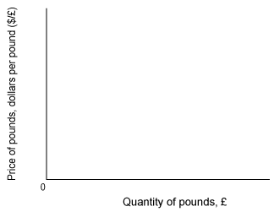
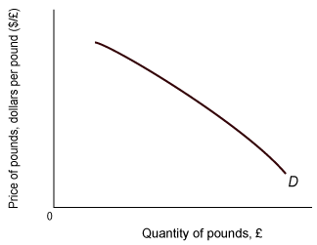
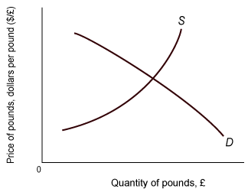
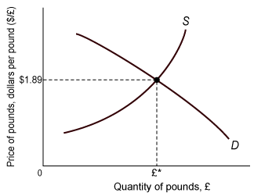
The Equilibrium Exchange Rate
The equilibrium exchange rate occurs at the point at which the quantity demanded of a foreign currency equals the quantity of that currency supplied.

Slide 18
Factors that Affect Exchange Rates
1. Differentials in Inflation 2. Differentials in Interest Rates
3. Current-Account Deficits
4. Public Debt 5. Terms of Trade 6. Political Stability and Economic Performance

Slide 19
Factors that Affect Exchange Rates
Differentials in Inflation---a country with a consistently lower inflation rate exhibits a rising currency value, as its purchasing power increases relative to other currencies.
Those countries with higher inflation typically see depreciation in their currency in relation to the currencies of their trading partners.

Slide 20
Factors that Affect Exchange Rates
Differentials in Interest Rates----Interest rates, inflation and exchange rates are all highly correlated. By manipulating interest rates, central banks exert influence over both inflation and exchange rates, and changing interest rates impact inflation and currency values. Higher interest rates offer lenders in an economy a higher return relative to other countries.

Slide 21
Therefore, higher interest rates attract foreign capital and cause the exchange rate to rise. The impact of higher interest rates is mitigated, however, if inflation in the country is much higher than in others, or if additional factors serve to drive the currency down.

Slide 22
Factors that Affect Exchange Rates
Current-Account Deficits----The current account is the balance of trade between a country and its trading partners, reflecting all payments between countries for goods, services, interest and dividends. A deficit in the current account shows the country is spending more on foreign trade than it is earning, and that it is borrowing capital from foreign sources to make up the deficit.
Notes:
To buy bonds in the United States, British buyers must exchange pounds for dollars (or supply their pounds in exchange for dollars). With higher interest rates in the United States, U.S. citizens are less likely to be interested in British securities, so they demand less pounds.

Slide 23
The Effects of Exchange Rates on the Economy
When a country’s currency depreciates (falls in value), its import prices rise and its export prices (in foreign currencies) fall.
When the U.S. dollar is cheap, U.S. products are more competitive in world markets, and foreign-made goods look expensive to U.S. citizens.

Slide 24
The Effects of Exchange Rates on the Economy
A depreciation of a country’s currency can serve as a stimulus to the economy:
Foreign buyers are likely to increase their spending on Jamaican goods
Buyers substitute Jamaican-made goods for imports
Aggregate expenditure on domestic output will rise
Inventories will fall
GDP (Y) will increase

Slide 25
Exchange Rates and the Balance of Trade: The J Curve
The balance of trade is equal to export revenue minus import costs:
balance of trade = dollar price of exports x quantity of exports − dollar price of imports x quantity of imports
According to the J-curve effect, the balance of trade gets worse before it gets better following a currency depreciation.

Slide 26
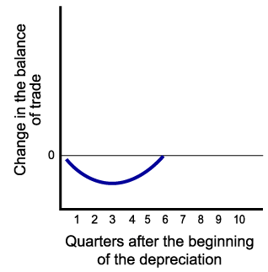
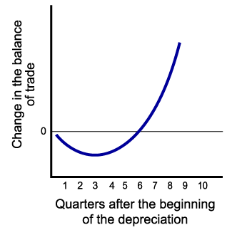
Exchange Rates and the Balance of Trade: The J Curve
Initially, the negative effect on the price of imports may dominate the positive effects of an increase in exports and a decrease in imports.
But when imports and exports have had a time to respond to price changes, the balance of trade improves.

Slide 27
Exchange Rates and Prices
Depreciation of a country’s currency tends to increase the price level.
Export demand rises.
Domestic buyers substitute domestic products for the now more expensive imports.
If the economy is operating close to capacity, the increase in aggregate demand is likely to result in higher prices.
If import prices rise, costs may rise for business firms, shifting the AS curve to the left.

Slide 28
Trade and Exchange Rates in a Two-Country/Two-Good World
Exchange rates determine the terms of trade.
Domestic Prices of Timber (Per Foot) and Rolled Steel (Per Meter) in the United States and Brazil
 | UNITED STATES | BRAZIL
Timber | $1 | 3 Reals
Rolled steel | $2 | 4 Reals
The option of buying at home or importing will depend on the exchange rate.

Slide 29
Trade and Exchange Rates in a Two-Country/Two-Good World
Trade Flows Determined by Exchange Rates
EXCHANGE RATE | PRICE OF REAL |  | RESULT
$1 = 1 R | $1.00 |  | Brazil imports timber and steel
$1 = 2 R | .50 |  | Brazil imports timber
$1 = 2.1 R | .48 |  | Brazil imports timber; United States imports steel
$1 = 2.9 R | .34 |  | Brazil imports timber; United States imports steel
$1 = 3 R | .33 |  | United States imports steel
$1 = 4 R | .25 |  | United States imports timber and steel

Slide 30
Exchange Rates and Comparative Advantage
If exchange rates end up in the right ranges, the free market will drive each country to shift resources into those sectors in which it enjoys a comparative advantage.
Only those products in which a country has a comparative advantage will be competitive in world markets.

